Slide 1

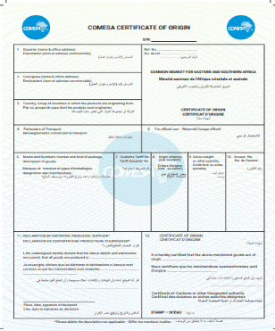
Overview OF the COMESA ELECTRONIC CERTIFICATE OF ORIGIN (e-CO)
.
Burundi
Comoros
Djibouti
DRC
Egypt
Ethiopia
Kenya
Madagascar
Libya
Mauritius
Somalia
Sudan
Tunisia
Uganda
Zambia
Zimbabwe
Malawi
Rwanda
Seychelles
Eritrea
Eswatini
Kenya National Launch of the COMESA e-CO
September 2025, Nairobi, Kenya

Slide 2

















Background
Burundi
Comoros
D R Congo
Djibouti
Egypt
Eritrea
Eswatini
Ethiopia
Kenya
Libya
Madagascar
12. Malawi
13. Mauritius
14. Rwanda
15. Seychelles
16. Somalia
17. Sudan
18. Tunisia
19. Uganda
20. Zambia
21. Zimbabwe
Formed in 1994 to replace the former Preferential Trade Area (PTA) which had existed from the earlier days of 1981. With its 21 Member States,

Slide 3
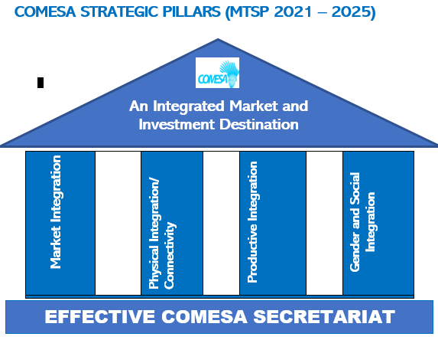
BACKGROUND
COMESA INTEGRATION STRATEGY
COMESA aims to achieve the removal of all physical, technical, fiscal and monetary barriers to intra-regional trade and commercial exchanges;
COMESA’s current strategy can be summed up as ‘economic prosperity through regional integration’.

Slide 4
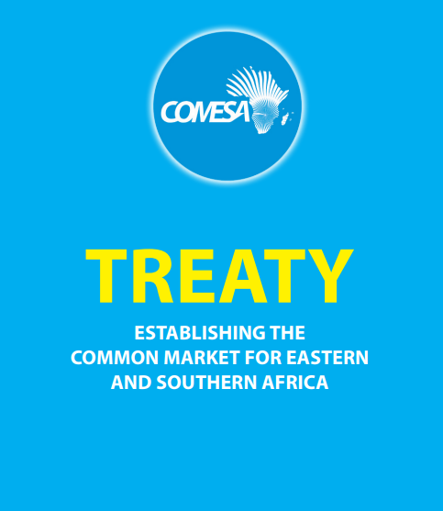
COMESA LEGAL FRAMEWORK:
COMESA Treaty (Article 46) Customs Duties
……. The Member States shall reduce and ultimately eliminate by the year 2000, in accordance with the programme adopted by the PTA Authority, customs duties and other charges of equivalent effect imposed or in connection with the importation of goods which are eligible for Common Market Tariff treatment

Slide 5
COMESA LEGAL FRAMEWORK
COMESA Treaty (Article 48): Rules Of Origin
……. goods shall be accepted as eligible for Common Market tariff treatment if they originate in the Member States.
2) The definition of products originating in the Member States shall be as provided for in a Protocol on the Rules of Origin ...
3) The Intergovernmental Committee shall, from time to time, examine the rules …….and propose amendments thereto to the Council.
Current Protocol on Rules of Origin (Annex to the Treaty):
Rules 1 – 14
Appendices I – VI

Slide 6
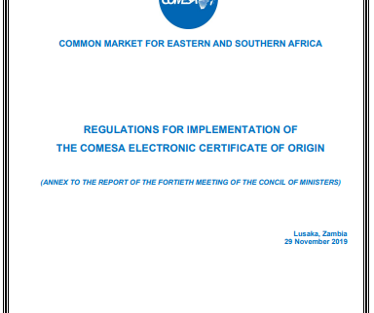
Council Decisions related to the e-CO
32nd Meeting of Council of Ministers (2014 )
urged the Member States that are ready to accept and use the e-CO should do so; and
urged the Member States whose legal systems do not provide for e-CO to enact enabling laws as soon as possible with the view to replace the manual certificate of origin with the e-CO.
37th Meeting of Council of Ministers (2017)
Adopted the COMESA DFTA Action Plan of e-legislation, e-trade and e-logistics.
A phased approach should be adopted for rolling out the instruments for Digital FTA, beginning with the instruments that are ready and member states who are willing/ready to participate.
40th Meeting of Council of Ministers (2019)
Adopted Regulations for the Implementation of eCO

Slide 7
REGIONAL ROADMAP OF IMPLEMENTATION OF E-CO
(4) National Consultations Country Specific Action Plan for Integration and Piloting the eCO
(3) National Situational Self-Assessment and Identification of Requirements
(8)Launch Piloting and Go-Live for full implementation
(2) Dev’t of the COMESA eCO system + Review Legal Frameworks and Procedures
(9) Continue Technical Support and Maintenance
(7) Training & Sensitization of National Officers and Stakeholders
(5) Technical Interface/Integration of COMESA eCO system with National Systems
(1) Comprehensive Study and Business Process Analysis
(6) Review/dev’t of National Legal Framework and Procedures

Slide 8
Progress - COMESA e-CO Project Activities
(With funding from the EU, under the 11 EDF Trade Facilitation Programme)
Developed the COMESA eCO system based on the Protocol and Comprehensive Business Process Analysis.
Adopted COMESA Regulations for implementation of the eCO.
Adoption of Amendments to the COMESA Protocol on Rules of Origin.
Situational Assessment of Member States readiness for piloting the e-CO.
National consultations with key stakeholders to prepare country specific action plans and requirements.
6) Completed Interfacing of COMESA e-CO system with national e-CO systems of Eswatini, Malawi, Zambia and Zimbabwe while interfacing/testing is in progress for Seychelles, Zimbabwe, Kenya and Ethiopia and Djibouti.
7) Conducted Training and Sensitisation of Issuing/Customs officers and private stakeholders at project Member States.
Djibouti
Eswatini,
Ethiopia,
Kenya
Madagascar
Malawi
7. Mauritius,
Rwanda,
Seychelles
10. Uganda,
11. Zambia
12.Zimbabwe

Slide 9
Model of the COMESA eCO system
COMESA eCO system is a web-based system that covers end-to-end Process.
User Registration
Exporter’s Registration Process
Online application for registration Online approval of registration
Application and issuance of eCO process at Exporting Country
Online application for CO Online issuance of eCO
Checking and Verification of eCO Process in Importing Country
Online receive and submit eCO to Customs Online Verification of eCO by Customs
Usage of Certificate of Origin

Slide 10
Current Statistics on the eCO
4 Countries Integrated
Kenya is the 5th Country to be integrated
374 Registered Exporters
5,466 eCOs Issued
576 eCOs destined to Kenya

Slide 11
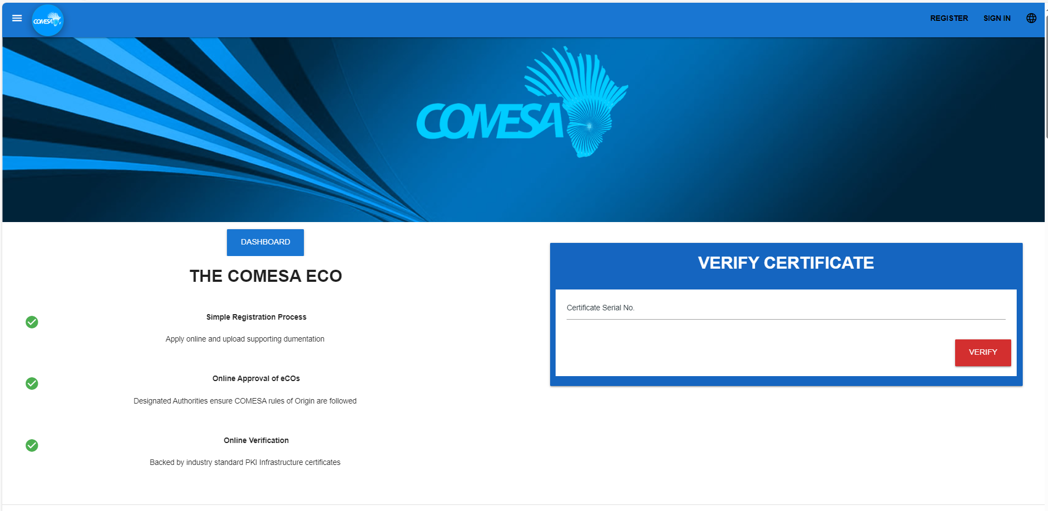
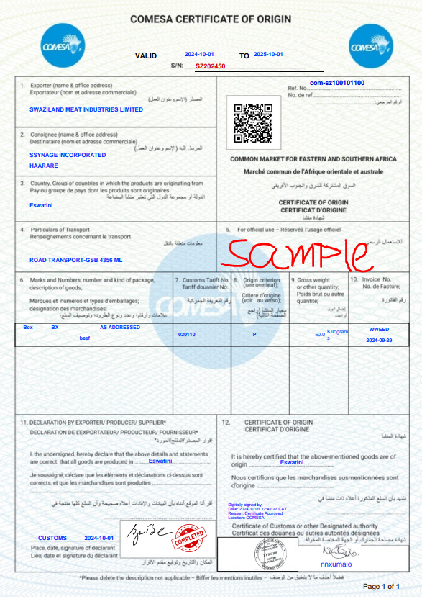
https://eco.comesa.int

Slide 12
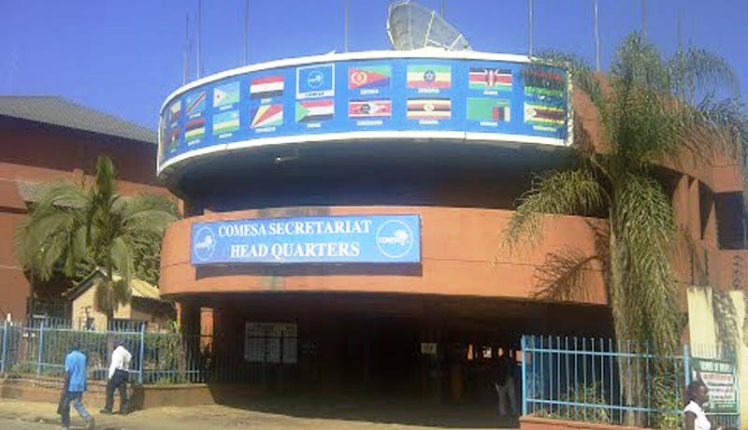
Thank You! Merci ! شكرا
Further Information contact COMESA Secretariat:
COMESA SECRETARIAT
Trade and Customs Division
Ben Bella Road
P.O. Box 30051. Lusaka, Zambia
Tel: +260 211 229 725
Email: info@comesa.int
URL: https://eco.comesa.int/

